Slide 1
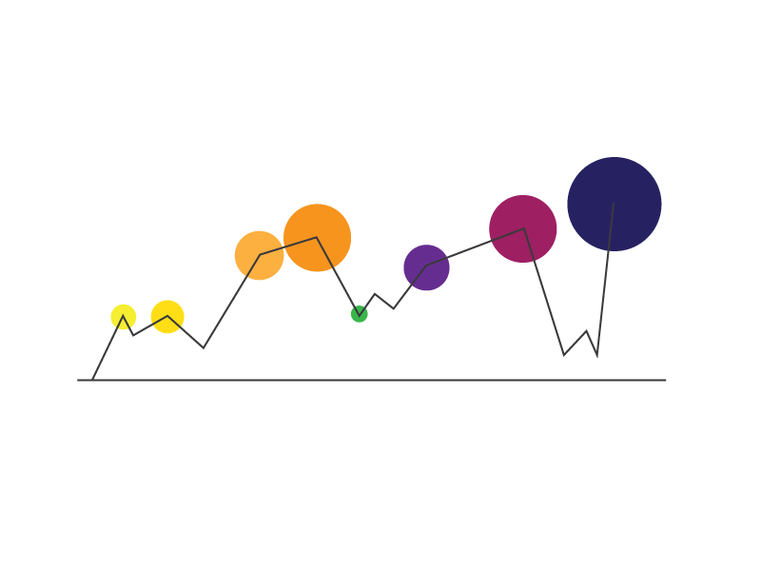
R and Visualization: A Match Made in Heaven

Slide 2





What will you learn today?
Have a basic understanding of Data Visualization as a field
Create basic and advanced Graphs in R
Change colors or use custom palettes
Customize graphical parameters
Learn basics of Grammar of Graphics
Spatial analysis Visualization

Slide 3
Data Visualization In R
Part 1 : What is Data Visualization ?
Study of the visual representation of data
More than pretty graphs
Gives insights
Helps decision making
Accurate and truthful
Why Data Visualization?
"Lies, damned lies, and statistics" is a phrase describing the persuasive power of numbers, particularly the use
of statistics to bolster weak argument
Cue to Anscombe-Case Study
Source- Anscombe (1973) http://www.sjsu.edu/faculty/gerstman/StatPrimer/anscombe1973.pdf

Slide 4
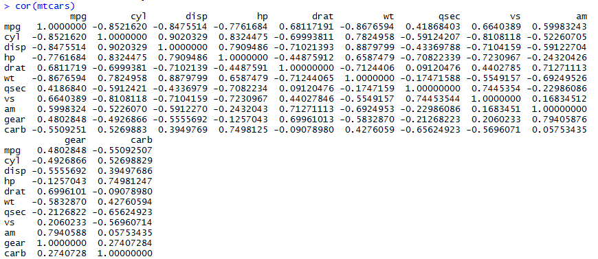
Data Visualization In R
Part 2 : Does This Make Sense?
> cor(mtcars)

Slide 5
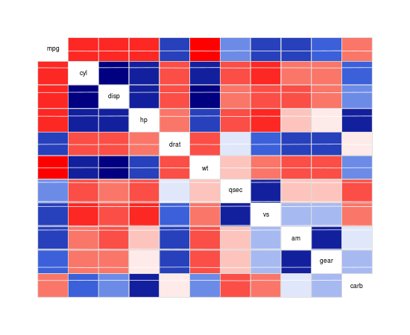
Data Visualization In R
Part 2 : Does This Make Better Sense?
Library(corrgram)
Corrgram(mtcars) RED is negative BLUE is positive
Darker the color, more the correlation

Slide 6
Basic graphs in R
Part 3 : Basic graphs in R (Which one should we use and when?)
Pie Chart (never use them)
Scatter Plot (always use them?)
Line Graph (Linear Trend)
Bar Graphs (When are they better than Line graphs?)
Sunflower plot (overplotting)
Rug Plot
Density Plot
Histograms (Give us a good break!)
Box Plots

Slide 7
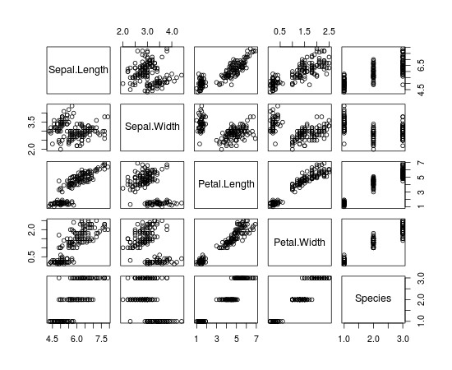
Basic graphs in R
Part 3 : Basic graphs in R
Plot(iris)
Plot the entire object
See how variables behave with each other

Slide 8
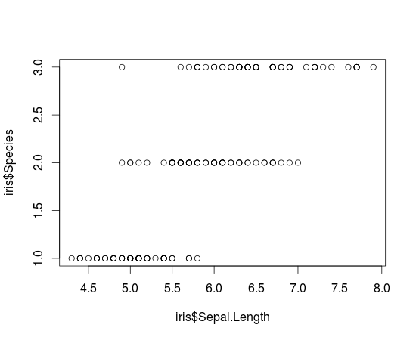
Basic graphs in R
Part 3 Basic graphs in R
Plot(iris$Sepal.Length, iris$Species)
Plot two variables at a time to closely examine relationship

Slide 9
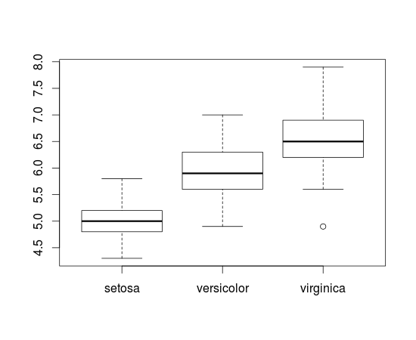
Basic graphs in R
Part 3 Basic graphs in R
Plot(iris$Species, iris$Sepal.Length)
Plot two variables at a time
Order is important
Hint- Keep factor variables to X axis Box Plot- Five Numbers! minimum, first quartile, median,
third quartile, maximum.

Slide 10
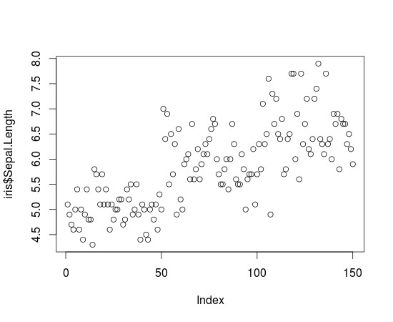
Basic graphs in R
Part 3 : Basic graphs in R
Plot(iris$Sepal.Length)
Plot one variable
Scatterplot

Slide 11
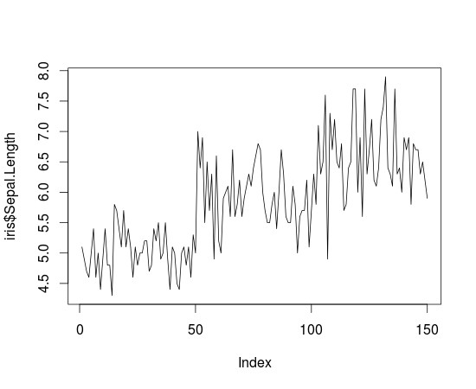
Basic graphs in R
Part 3 : Basic graphs in R
Plot(iris$Sepal.Length, type='l')
Plot with type='l'
Used if you need trend (usually with respect to time)
Line graph

Slide 12
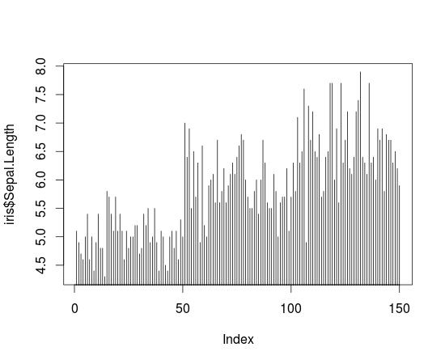
Basic graphs in R
Part 3 : Basic graphs in R
Plot(iris$Sepal.Length, type='h')
Graph

Slide 13
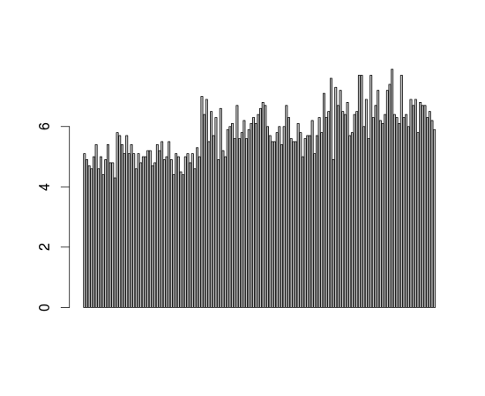
Basic graphs in R
Part 3 Basic graphs in R
Barplot(iris$Sepal.Length)
Bar graph

Slide 14
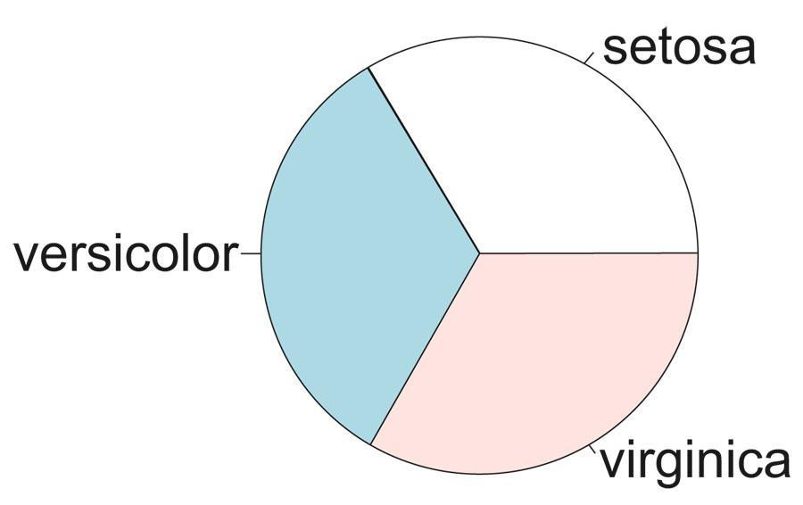
Basic graphs in R
Part 3 Basic graphs in R
Pie(table(iris$Species))
Pie graph
NOT Recommended

Slide 15
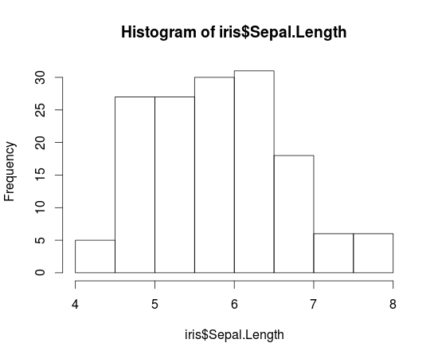
Basic graphs in R
Part 3 : Basic graphs in R
Hist(iris$Sepal.Length)

Slide 16
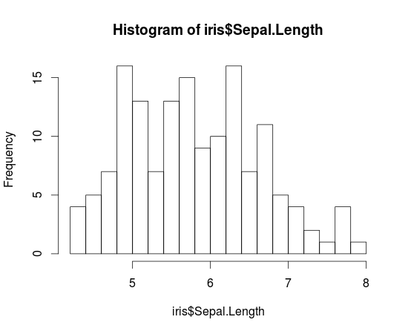
Basic graphs in R
Part 3 : Basic graphs in R
Hist(iris$Sepal.Length,breaks=20)

Slide 17
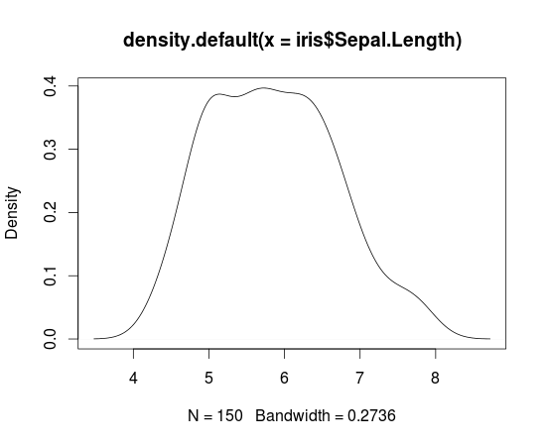
Basic graphs in R
Part 3 : Basic graphs in R
Plot(density(iris$Sepal.Length)

Slide 18
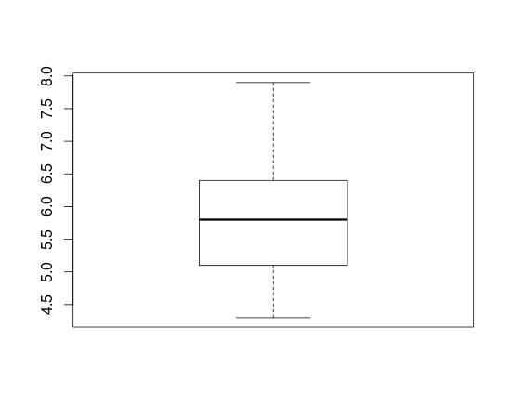
Basic graphs in R
Part 3 : Basic graphs in R
Boxplot(iris$Sepal.Length)
Boxplot

Slide 19
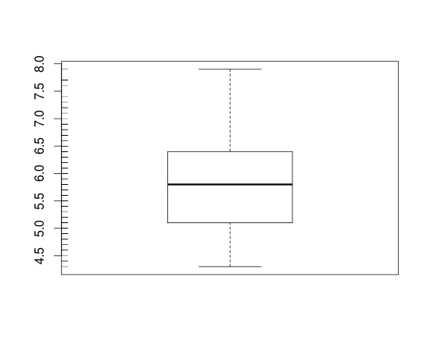
Basic graphs in R
Part 3 : Basic graphs in R
Boxplot with Rug
Boxplot(iris$Sepal.Length)
Rug(iris$Sepal.Length,side=2)
Adds a rug representation (1-d plot) of the data to the plot.

Slide 20
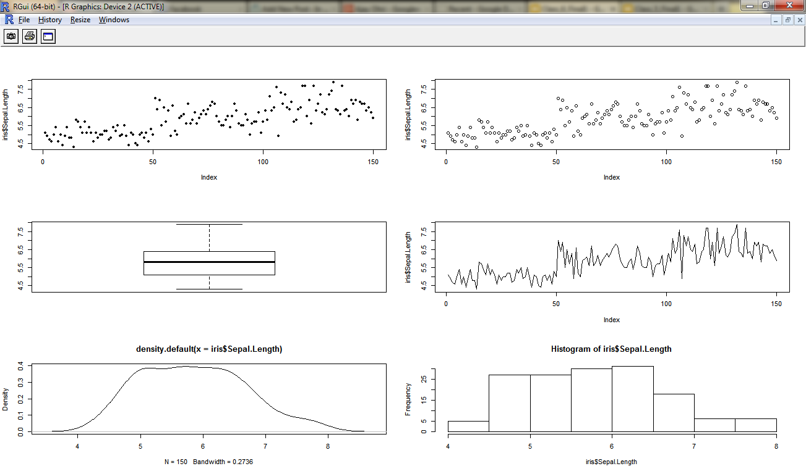
Customizing Graphs
Part 3 Customizing Graphs
Multiple graphs on same screen
par(mfrow=c(3,2))
> sunflowerplot(iris$Sepal.Length)
> plot(iris$Sepal.Length)
> boxplot(iris$Sepal.Length)
> plot(iris$Sepal.Length,type="l")
> plot(density(iris$Sepal.Length))
> hist(iris$Sepal.Length)

Slide 21

Customizing Graphs
Part 3 : Customizing Graphs
Multiple graphs on same screen
par(mfrow=c(3,2))
> sunflowerplot(iris$Sepal.Length)
> plot(iris$Sepal.Length)
> boxplot(iris$Sepal.Length)
> plot(iris$Sepal.Length,type="l")
> plot(density(iris$Sepal.Length))
> hist(iris$Sepal.Length)
???

Slide 22
Customizing Graphs
Part 3 : Customizing Graphs
Multiple graphs on same screen
par(mfrow=c(3,2))
> sunflowerplot(iris$Sepal.Length)
> plot(iris$Sepal.Length)
> boxplot(iris$Sepal.Length)
> plot(iris$Sepal.Length,type="l")
> plot(density(iris$Sepal.Length))
> hist(iris$Sepal.Length)
Over-plotting

Slide 23
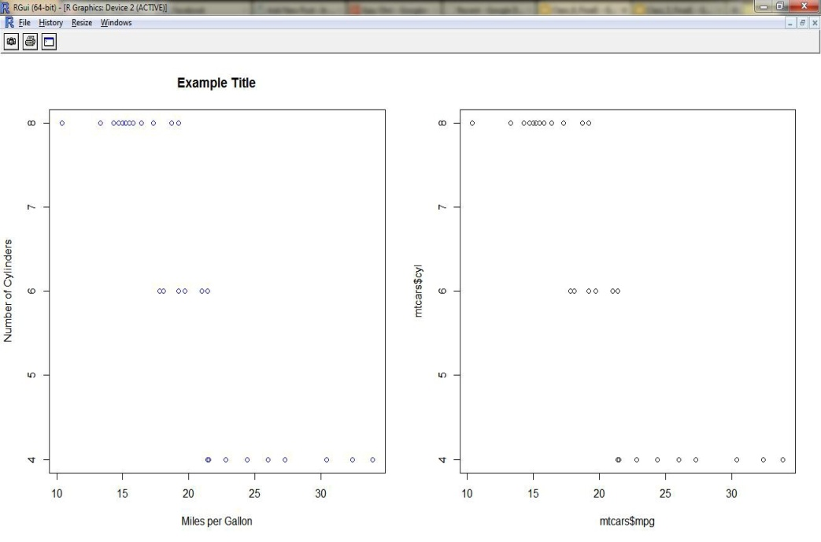
Customizing Graphs
Part 3 : Customizing Graphs
X Axis, Y Axis, Title, Color
par(mfrow=c(1,2))
> plot(mtcars$mpg,mtcars$cyl,main="Example Title",col="blue",xlab="Miles per Gallon", ylab="Number of Cylinders")
> plot(mtcars$mpg,mtcars$cyl)

Slide 24
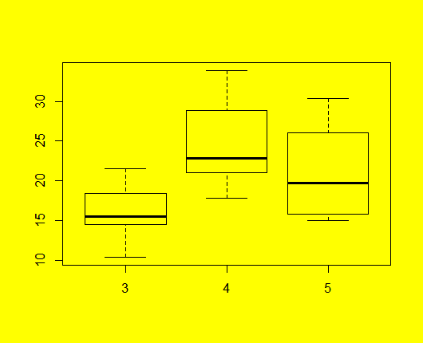
Customizing Graphs
Part 3 : Customizing Graphs
Background
Try a variation of this yourself par(bg="yellow") boxplot(mtcars$mpg~mtcars$gear)

Slide 25
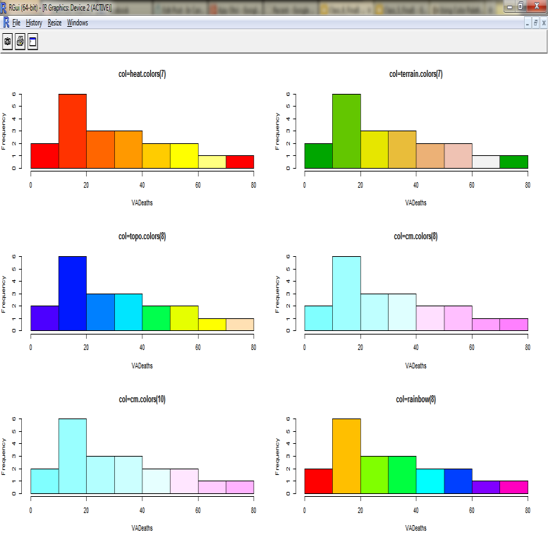
Customizing Graphs
Part 3 : Customizing Graphs
Use Color Palettes
> par(mfrow=c(3,2))
> hist(VADeaths,col=heat.colors(7),main="col=heat.colors(7)")
> hist(VADeaths,col=terrain.colors(7),main="col=terrain.colors(7)")
> hist(VADeaths,col=topo.colors(8),main="col=topo.colors(8)")
> hist(VADeaths,col=cm.colors(8),main="col=cm.colors(8)")
> hist(VADeaths,col=cm.colors(10),main="col=cm.colors(10)")
> hist(VADeaths,col=rainbow(8),main="col=rainbow(8)")
source- http://decisionstats.com/2011/04/21/using-color-palettes-in-r/

Slide 26
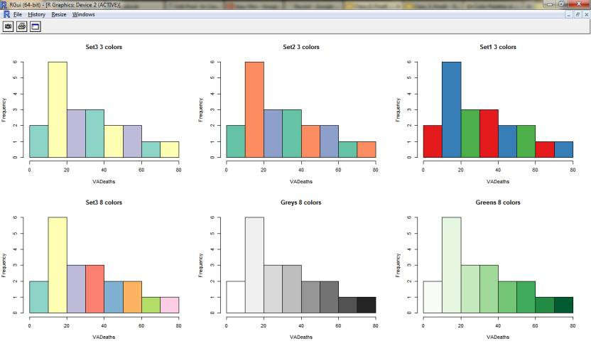
Customizing Graphs
Part 3 : Customizing Graphs
Use Color Palettes in RColorBrewer
> library(RColorBrewer)
> par(mfrow=c(2,3))
> hist(VADeaths,col=brewer.pal(3,"Set3"),main="Set3 3 colors")
> hist(VADeaths,col=brewer.pal(3,"Set2"),main="Set2 3 colors")
> hist(VADeaths,col=brewer.pal(3,"Set1"),main="Set1 3 colors")
> hist(VADeaths,col=brewer.pal(8,"Set3"),main="Set3 8 colors")
> hist(VADeaths,col=brewer.pal(8,"Greys"),main="Greys 8 colors")
> hist(VADeaths,col=brewer.pal(8,"Greens"),main="Greens 8 colors")
source- http://decisionstats.com/2012/04/08/color-palettes-in-r-using-rcolorbrewer-rstats/

Slide 27
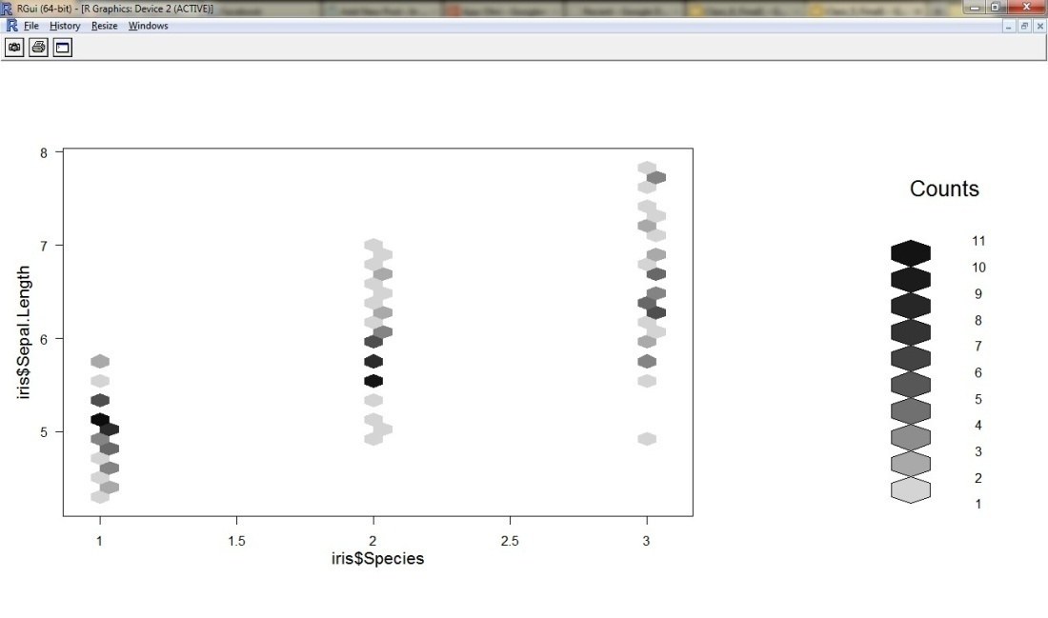
Advanced Graphs
Part 4 Advanced Graphs
Hexbin for over plotting
(many data points at same) library(hexbin)
plot(hexbin(iris$Species,iris$Sepal.Length))

Slide 28
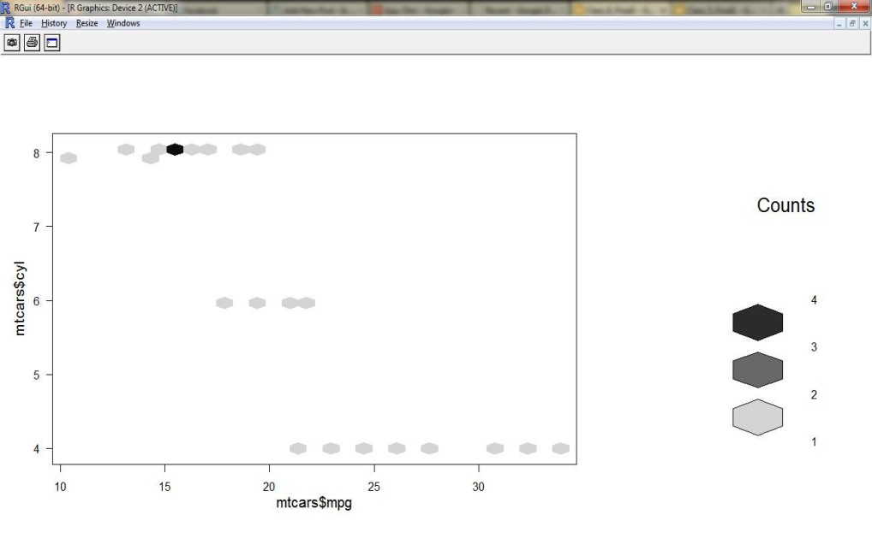
Advanced Graphs
Part 4 Advanced Graphs
Hexbin for over plotting(many data points are same)
library(hexbin)
plot(hexbin(mtcars$mpg,mcars$cyl))

Slide 29
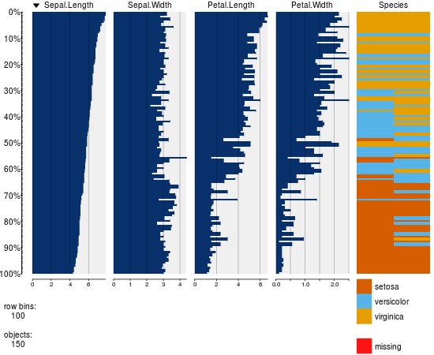
Advanced Graphs
Part 4 : Advanced Graphs
Tabplot for visual summary of a dataset
library(tabplot)
tableplot(iris)

Slide 30
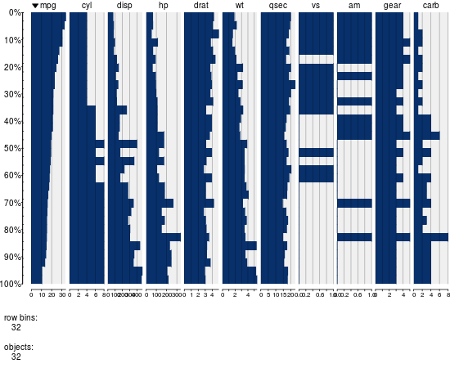
Advanced Graphs
Part 4 : Advanced Graphs
Tabplot for visual summary of a dataset
library(tabplot)
tableplot(mtcars)

Slide 31
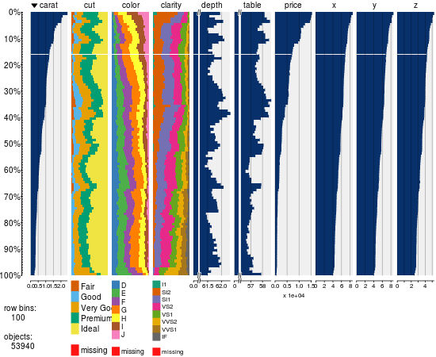
Advanced Graphs
Part 4 Advanced Graphs
Tabplot for visual summary of a dataset
Can summarize a lot of data relatively fast
library(tabplot) library(ggplot) tableplot(diamonds)

Slide 32
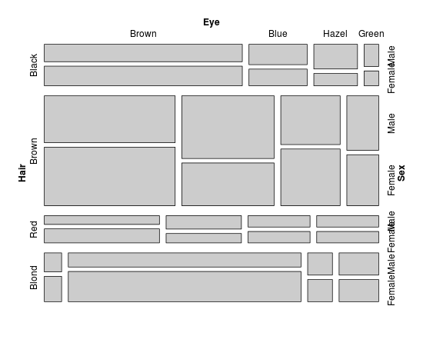
Advanced Graphs
Part 4 : Advanced Graphs
Vcd for categorical data
Mosaic
library(vcd) mosaic(HairEyeColor)

Slide 33
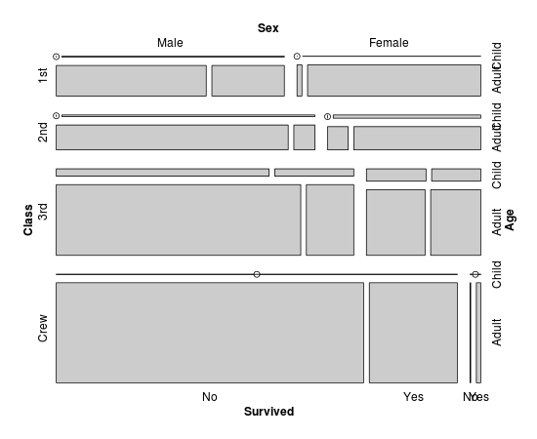
Advanced Graphs
Part 4 : Advanced Graphs
Vcd for categorical data
Mosaic
library(vcd) mosaic(Titanic)

Slide 34
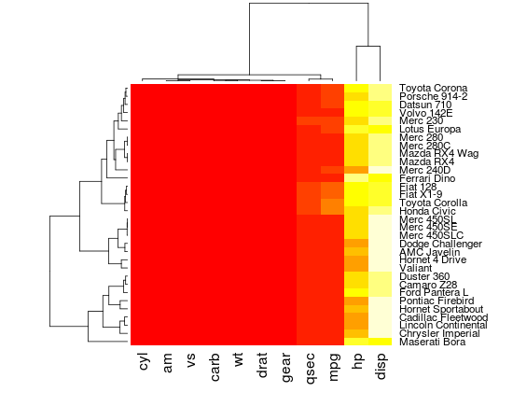
Advanced Graphs
Part 4 : Lots of Graphs in R
heatmap(as.matrix(mtcars))

Slide 35

Get Certified in R Analytics from Edureka
Go to www.edureka.co/r-for-analytics
Batch starts from 10th October (Weekend Batch)
Edureka's Mastering Data Analytics with R course:
An Online course covering Techniques of Regression, Predictive Analytics, Data Mining and Sentiment Analysis.
Online Live Courses: 24 hours
Assignments: 30 hours
Project: 25 hours
Lifetime Access + 24 X 7 Support

Slide 36
Thank You
Questions/Queries/Feedback
Recording and presentation will be made available to you within 24 hours

